Slide 1
Privacy Concerns on Contact Tracing App
Communities - Domain

Slide 2
Public perception on the privacy concern and its impact on the effectiveness of using voluntary mobile app-based technology as the primary medium for contact tracing in Brisbane.

Slide 3
Our process is easy
The presentation Roadmap
Research Topic Breakdown
User Research Methodology and Process
Future plans from this point

Slide 4
1. Research Topics and papers
Topics that have been researched with papers

Slide 5
Public Perception
What is the public perception of contact tracing?
How people feel and think about contact tracing
Negative or Positive?

Slide 6
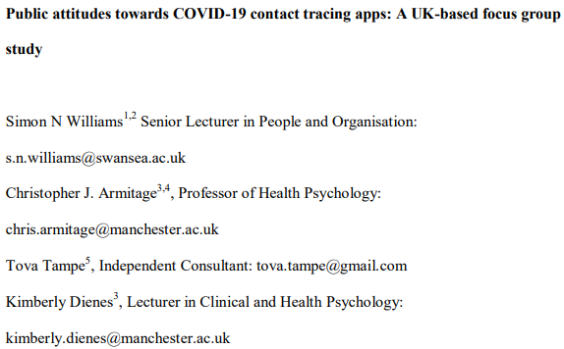
Public Perception – papers

Slide 7
Privacy Concern
What privacy concerns do people have on contact tracing?
There always has been concerns, but how specific about contact tracing?
People think contact tracing is a form of surveillance?

Slide 8
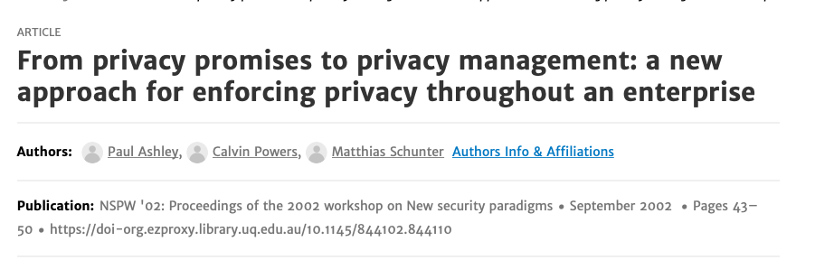
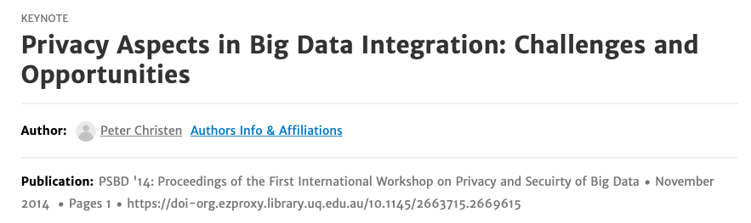
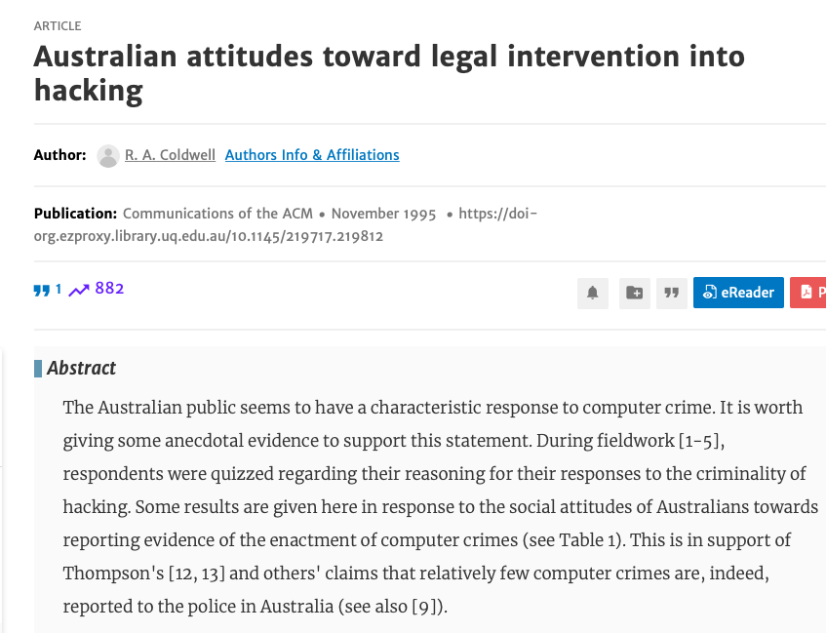
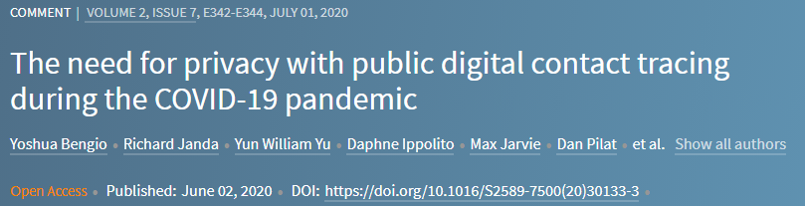
Privacy Concern - Papers

Slide 9
Actual Impact of the system
How much impact contact tracing app actually has
How is this actually useful

Slide 10
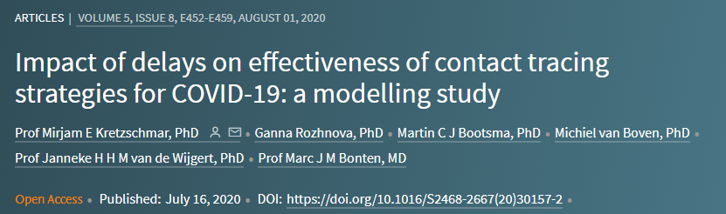
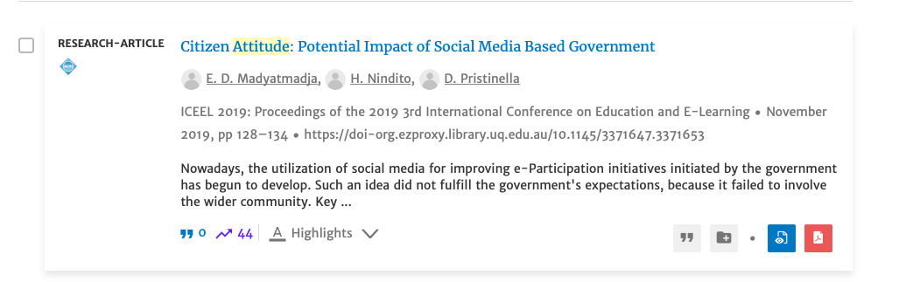

Actual Impact of the system – paper

Slide 11
Effectiveness of the system as mobile application
Is it more effective because it is mobile application based?
Is it more convenient and actually working?

Slide 12
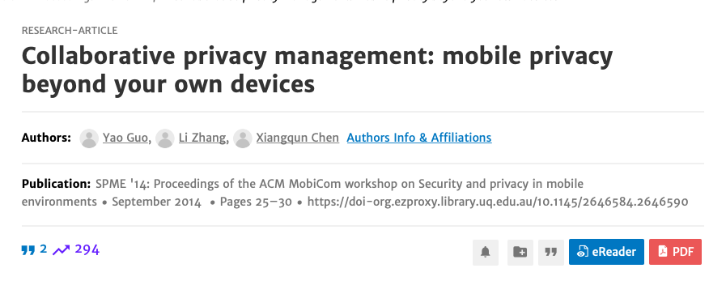
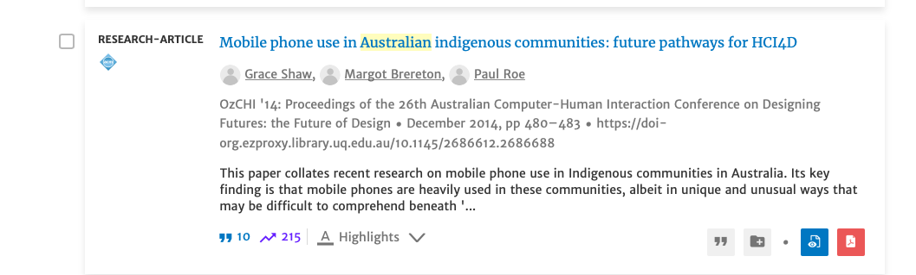
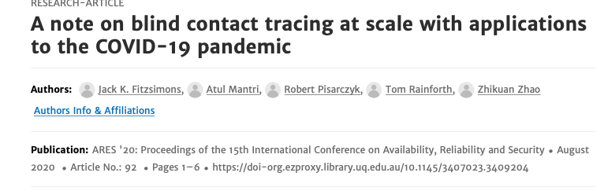
Effectiveness of the system as mobile application - paper

Slide 13
Primary Medium
People’s choice between QR Code and pen paper
Both can be used, but what does the shop owner or the customer prefer?

Slide 14
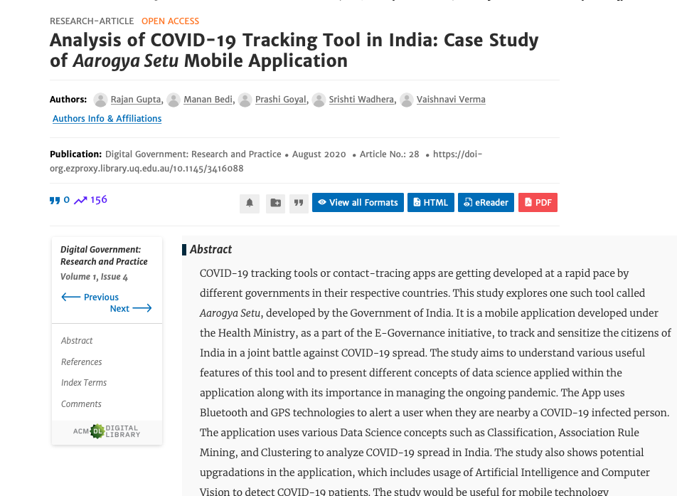
Primary Medium-paper

Slide 15
Contact tracing in Brisbane Area
The different ideas of different people in Brisbane Area
People have different ethnicity
People have different background. What does Brisbane people think?

Slide 16
2. User Research
User Interview and Cultural Probe

Slide 17
Interview - Plan
Aim – To collect data for initial privacy perception and briefing session for cultural probing
Tried to gather information from diverse people
Different age
Different job
Different ethnicity/background
From the research topics and readings interview questions have been created

Slide 18
Interview Procedures
Interviewees are given information about this interview
User reads through the consent form and signs it
Interview questions are asked. It will be recorded, and photos will be taken
Once the interview is finished users are given cultural probes to complete in 3 weeks

Slide 19
Interview Questions
1 | When was the last time that you went out from home? What sort of places did you go to?
2 | Were you asked to do any form of contact tracing? If so, what?
3 | If you answered QR code scan for question 2, what information were you asked to provide when creating the QR code, were you provided information about where or how it will be stored?
4 | Do you have any concerns about privacy issues when you scan the QR Code?
5 | Are you currently a student or a working person?
6 | At work, What application do you use for virtual chatting or meeting?
7 | If you mentioned zoom in 6, Do you have any privacy concerns while you are using that application (zoom)?
8 | What do you think when you first hear the word privacy ? or what comes into your mind ?
9 | I’m going to show you an article from the news, have a read at it and answer this question please. Do you have any differences of perception to data (privacy) breach before and after reading this article?
10 | Did you install the contact tracing app yourself?
11 | When did you install it ? Do you have any idea how it works?
12 | Did you give permissions to the contact tracing app to access your phone? Such as Bluetooth, WIFI or GPS? If yes why?
13 | Have you given proper reading to the questions asking for permissions?
14 | Do you think the contact tracing app is actually working?
15 | When or how did you know that you had to install the contact tracing
16 | What were you thinking when you had to repeatedly scan the QR code in the same area on the same day.
17 | Do you think contact tracing is effective?
18 | Do you have any concern that you might get junk mail?
19 | I’m going to give you a set of probes which you have to interact with and fill out three times a week for 3 weeks. Do you agree with this?

Slide 20
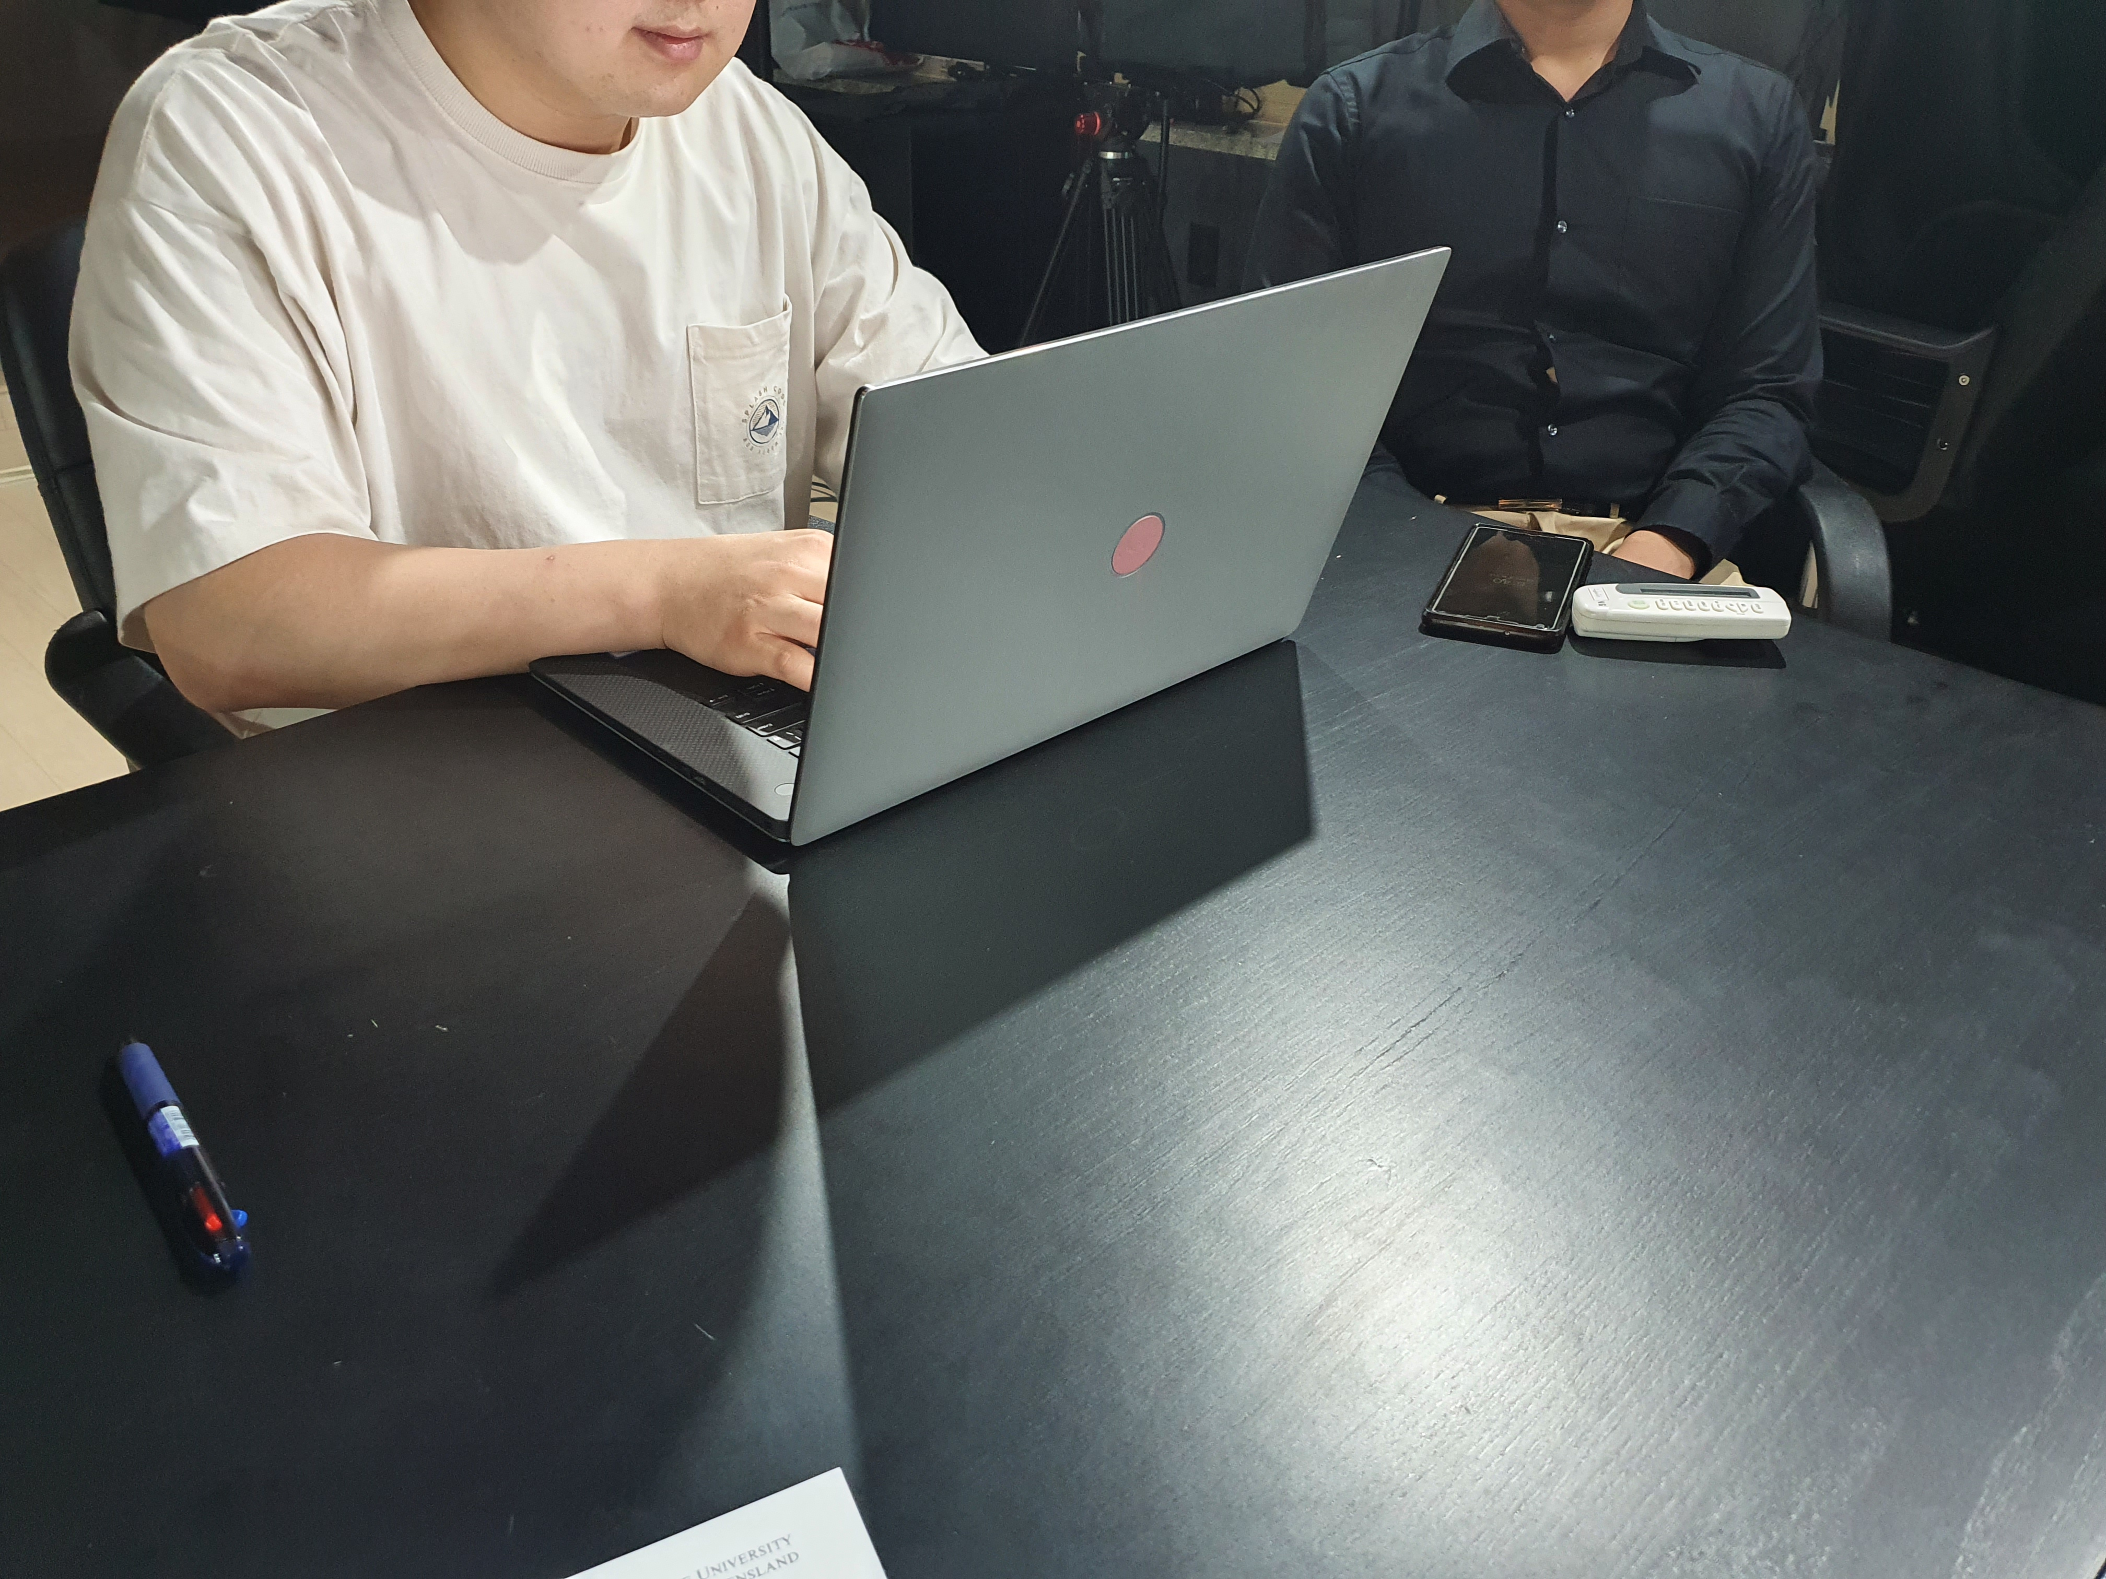
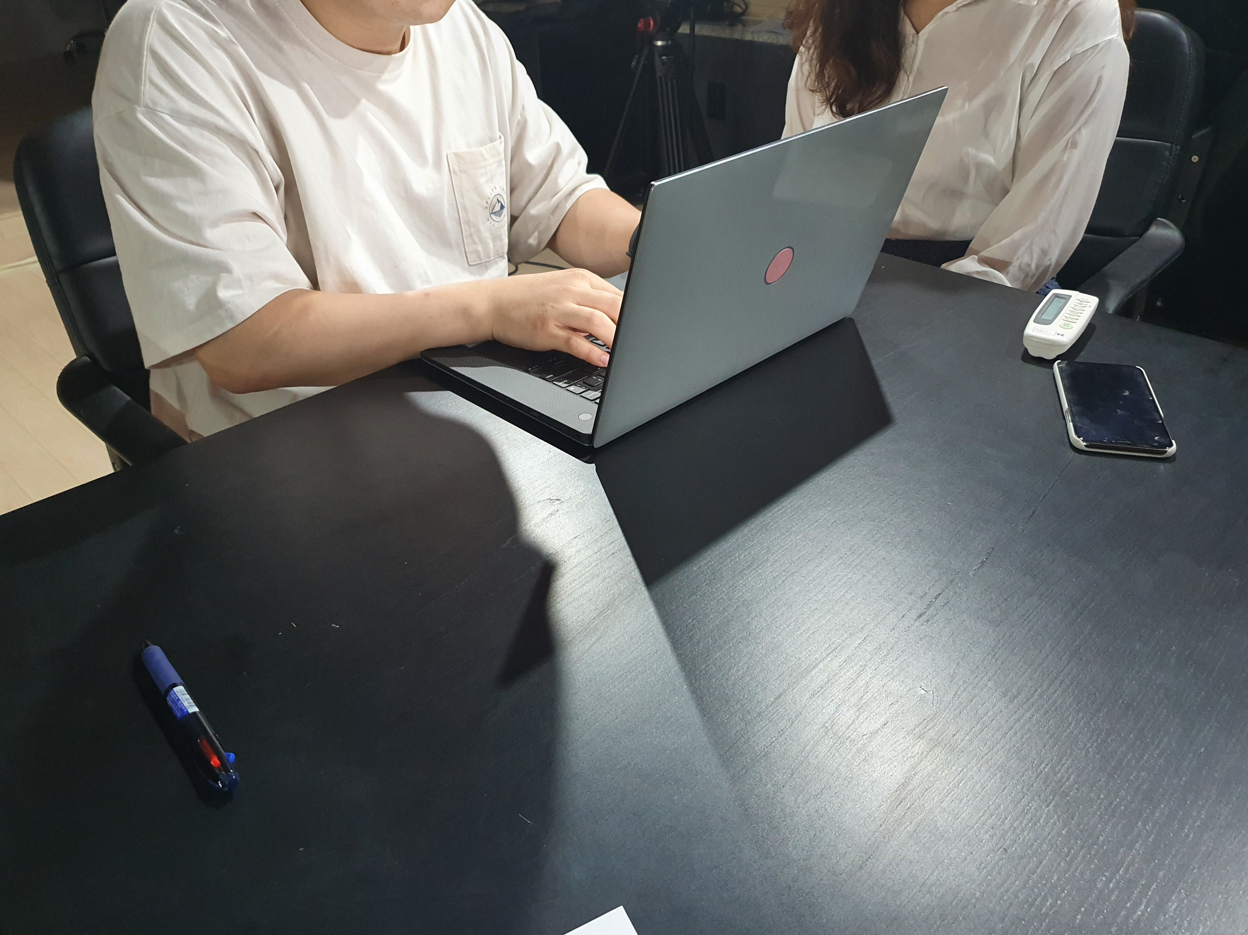
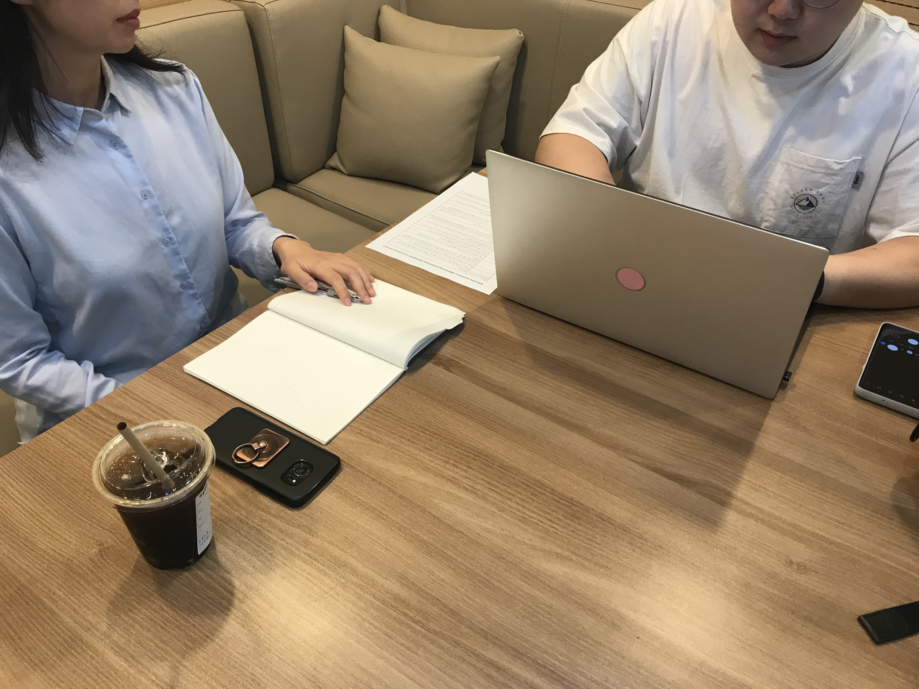
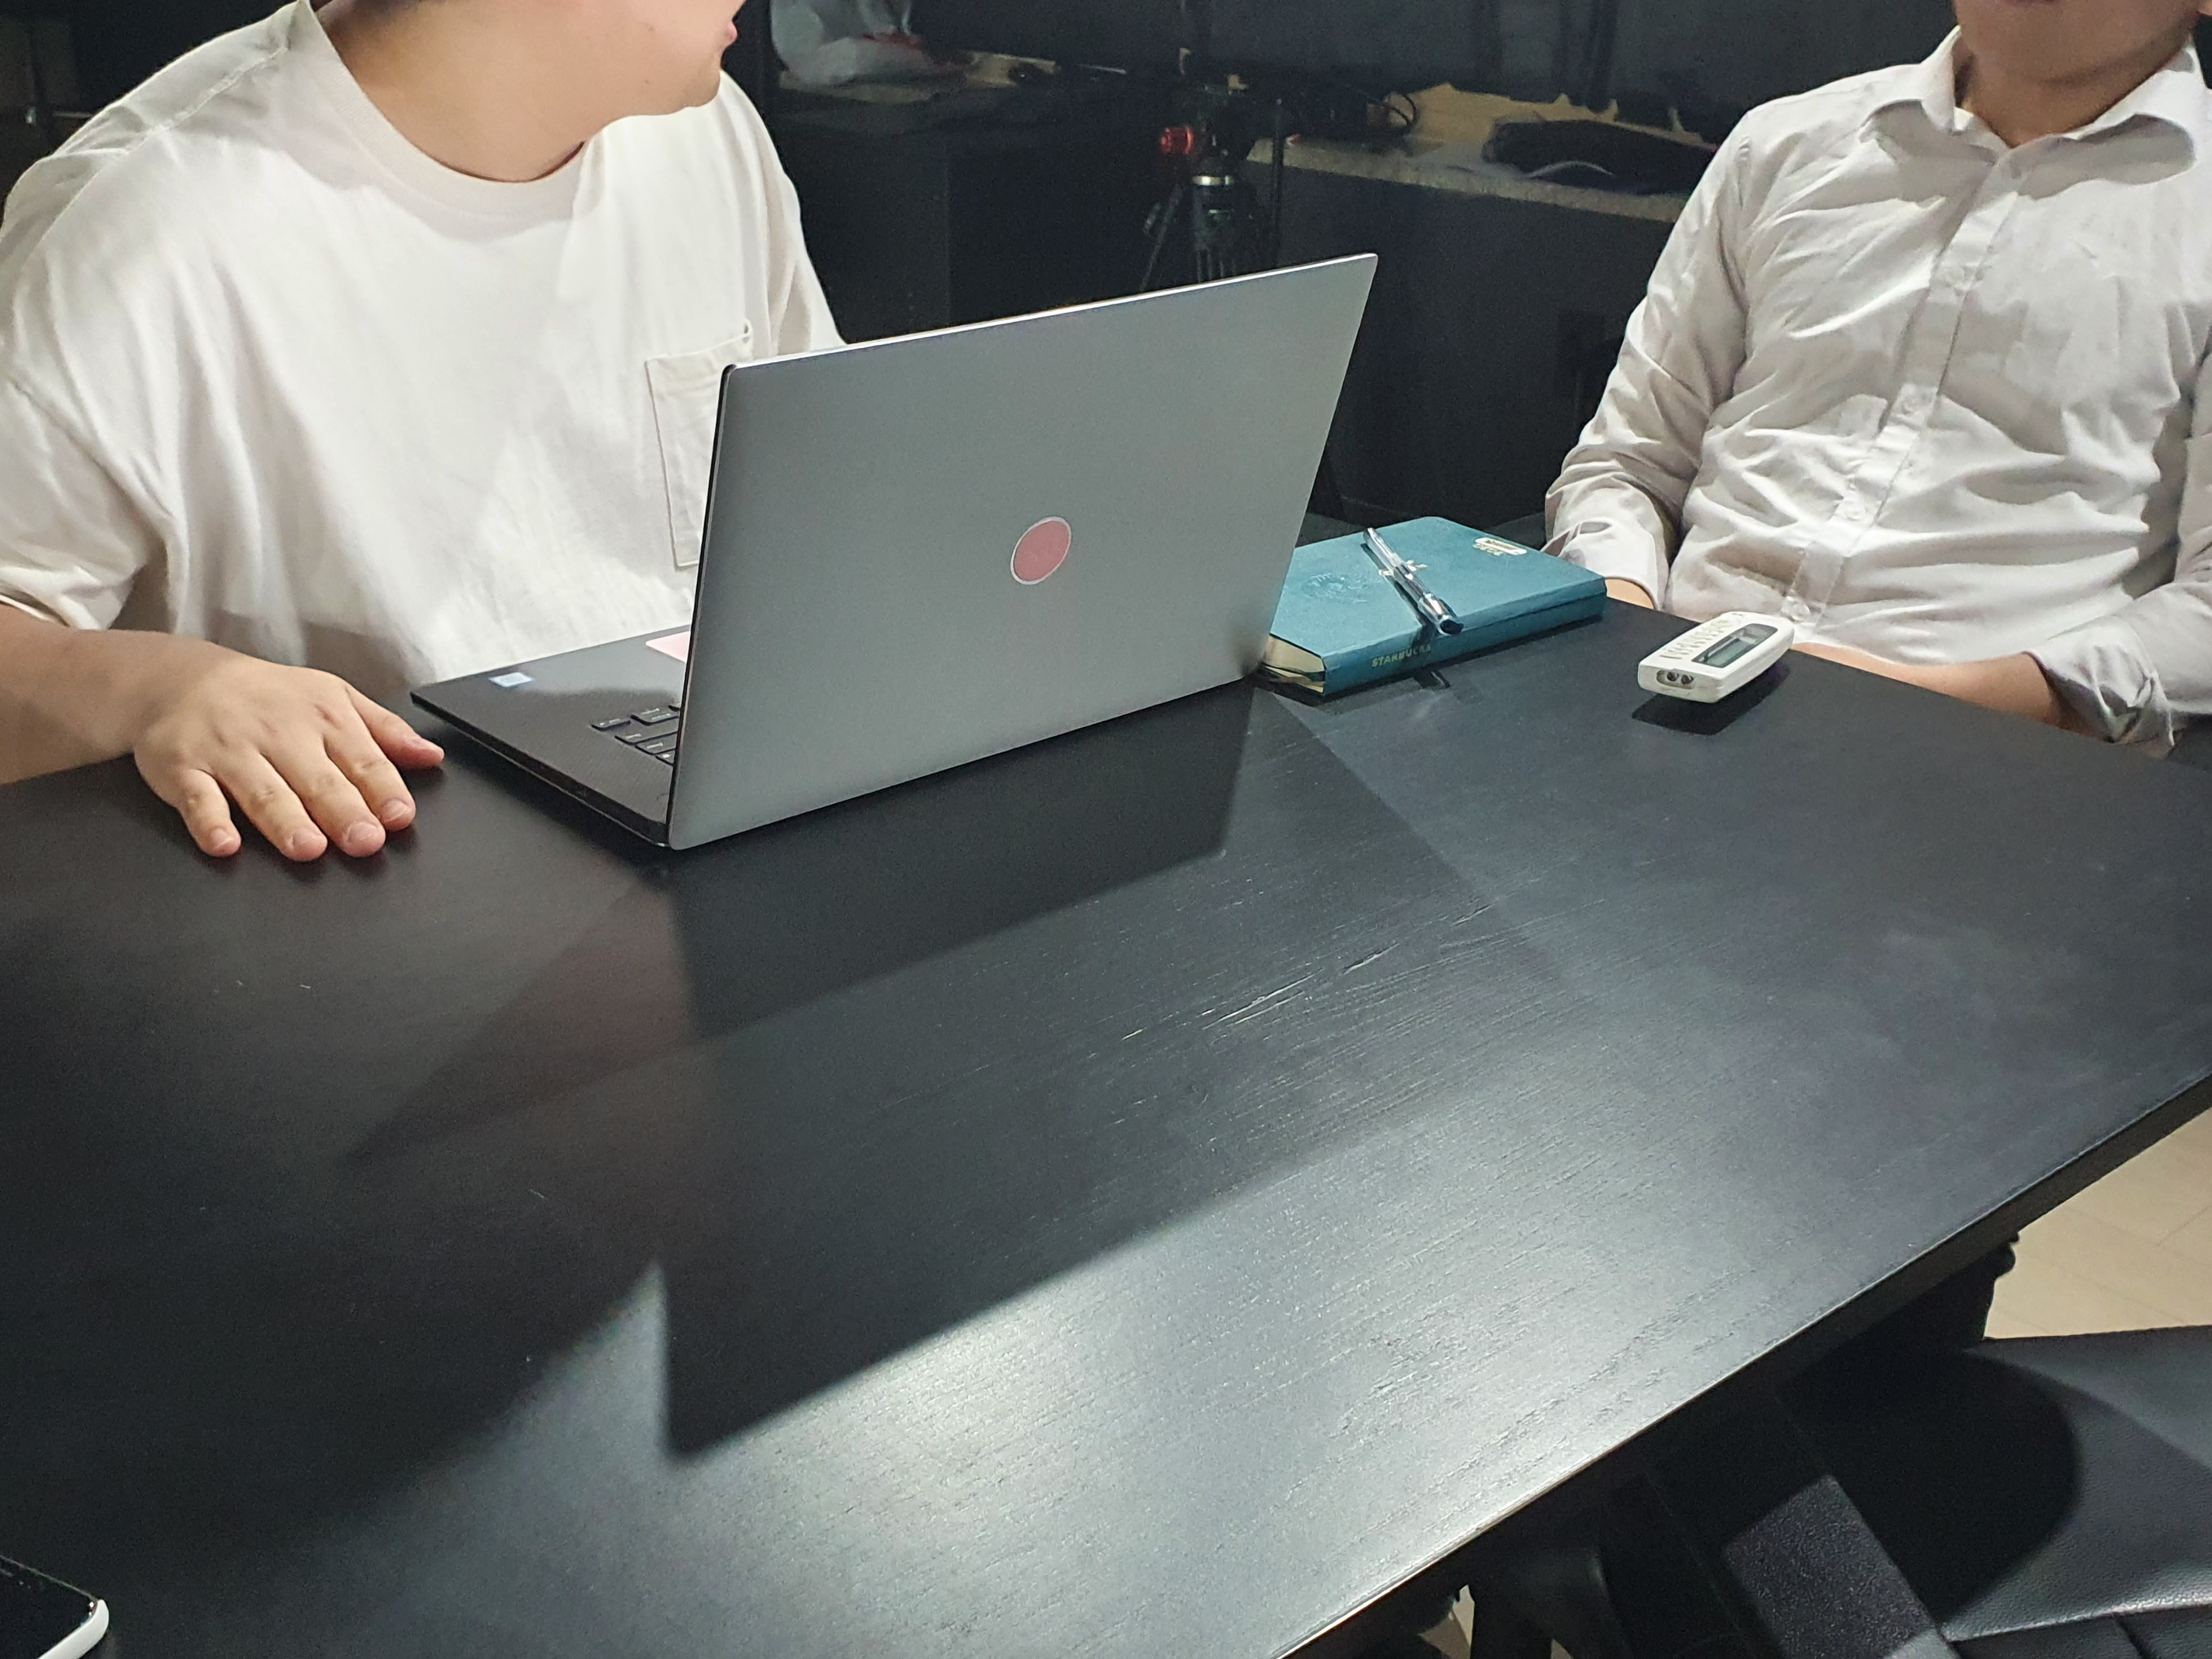
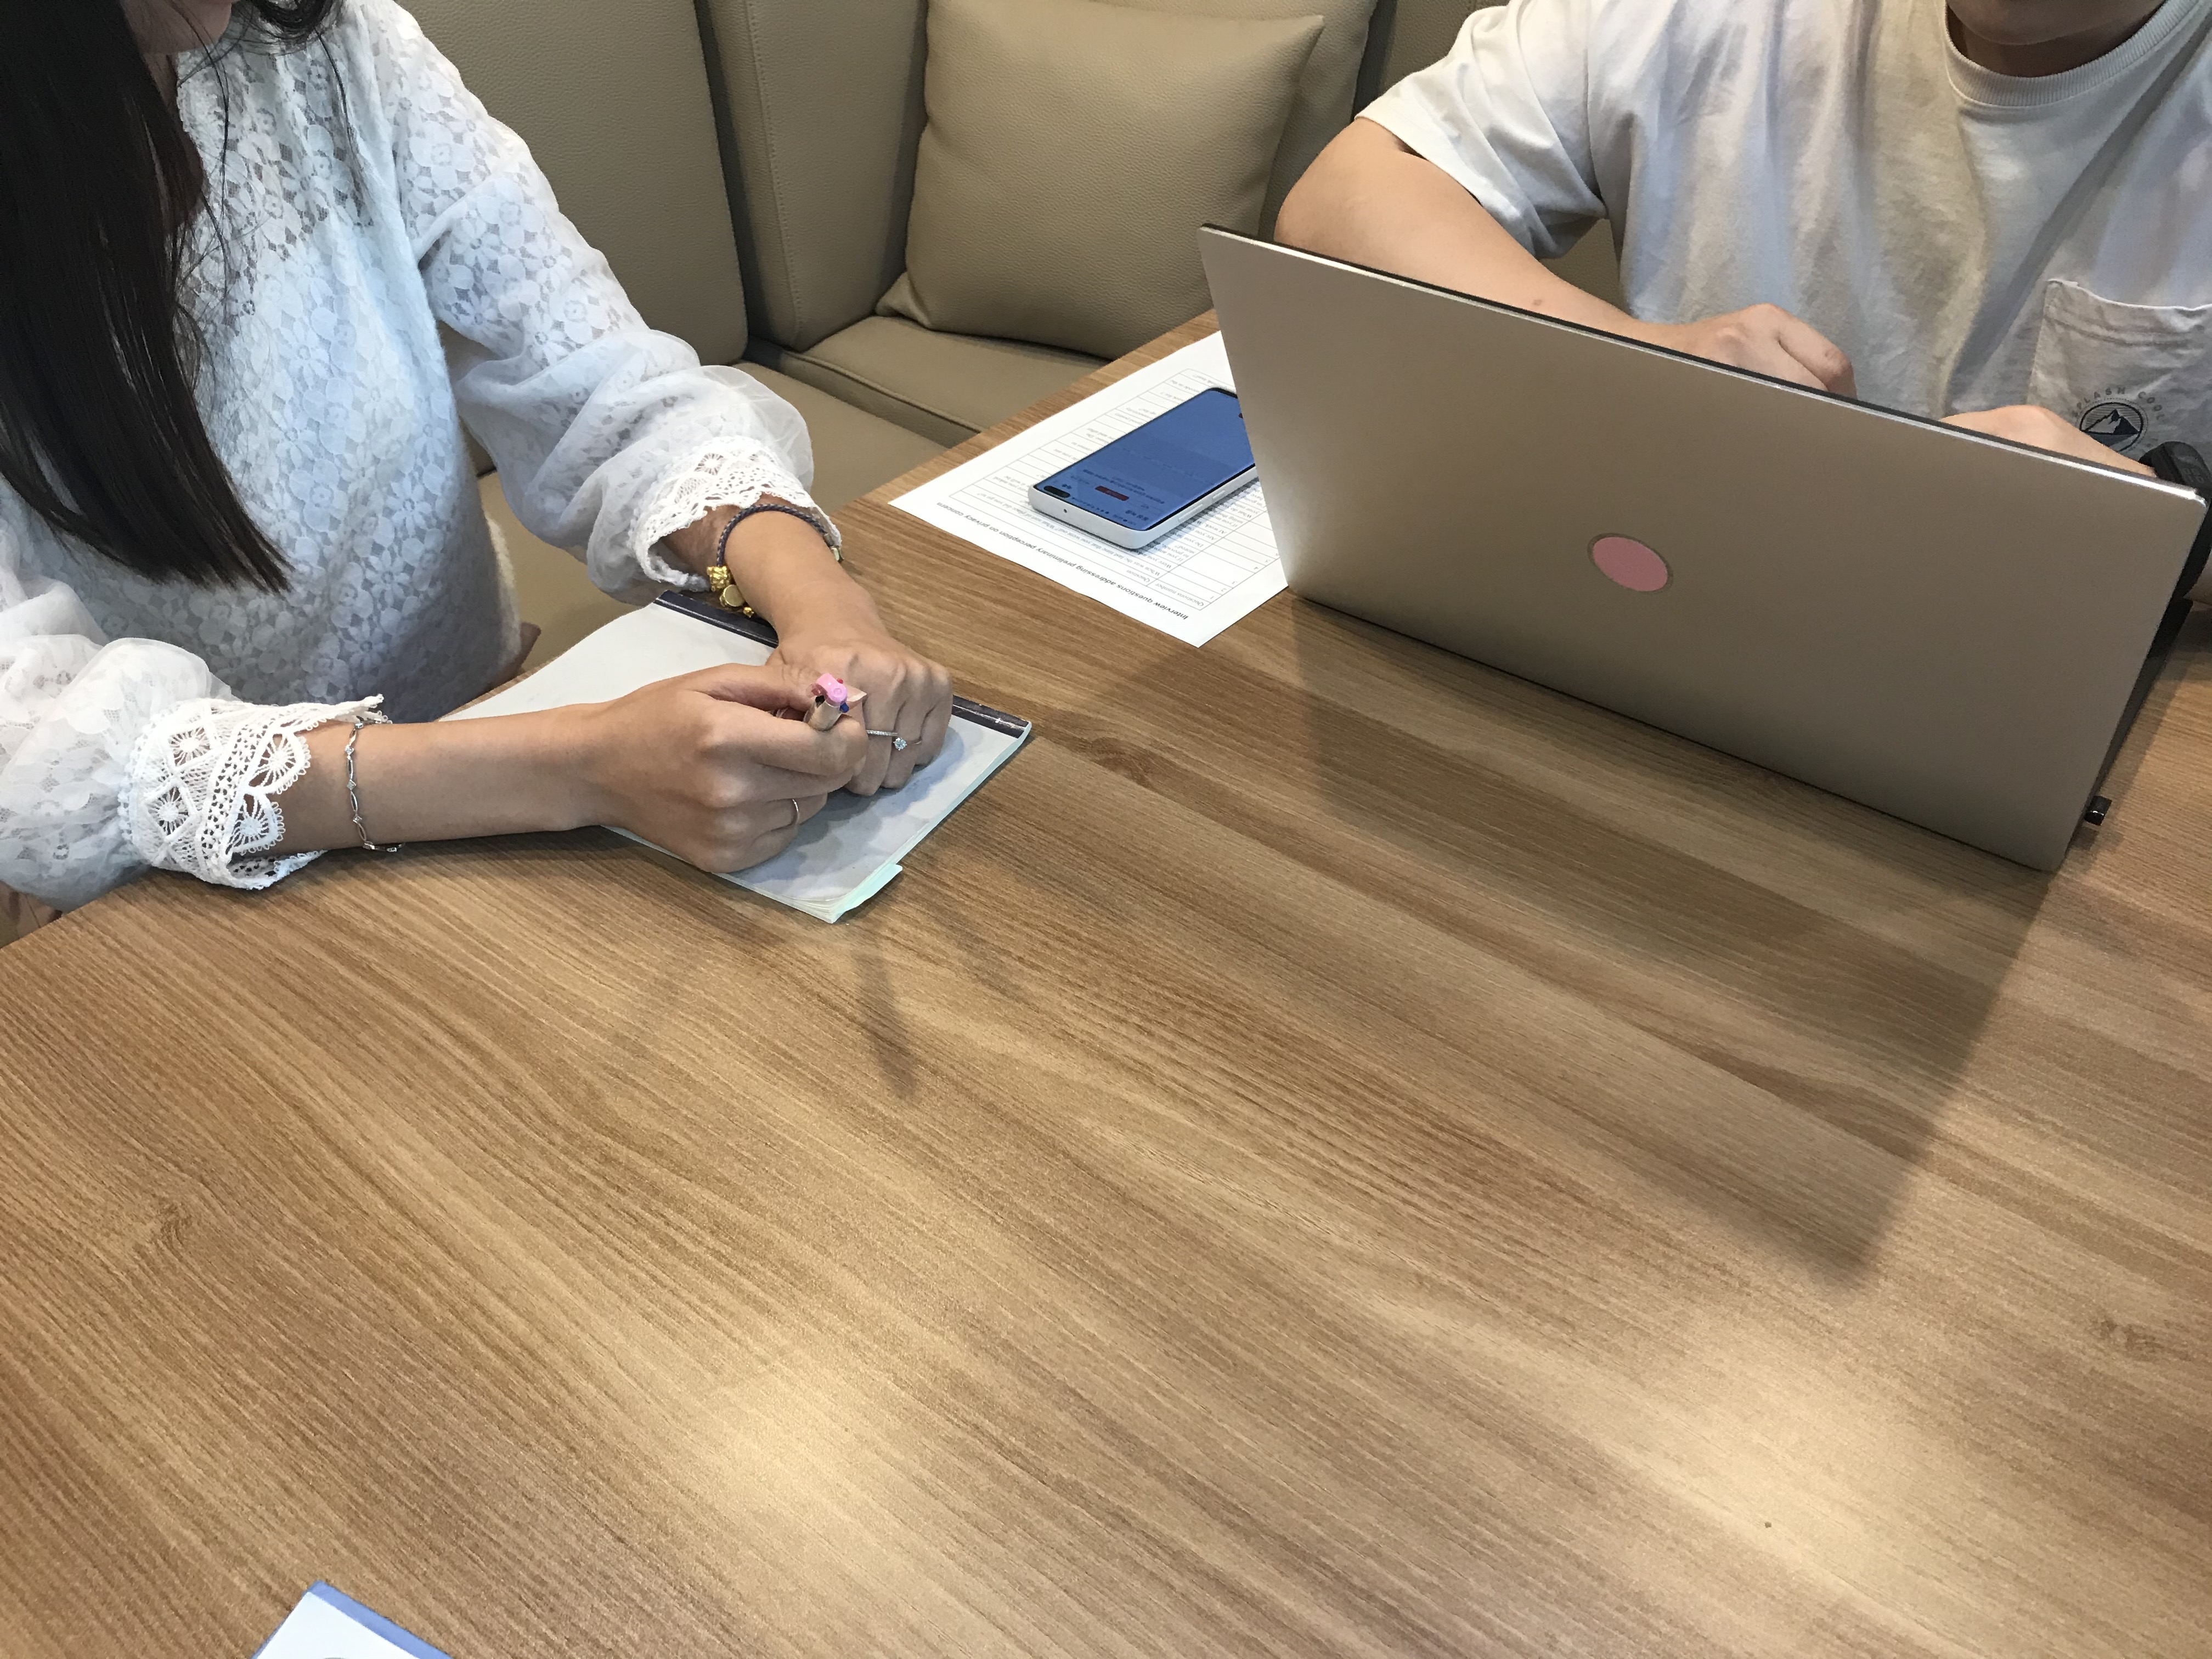
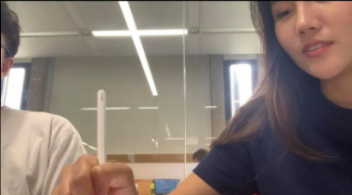
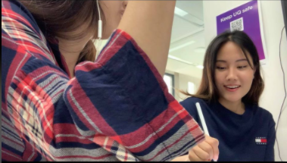
Photos from Interview

Slide 21
Current Interview Status
Aimed to collect 14 from different groups of people
Total of 11 number of interviews conducted

Slide 22
Cultural Probe
We will primarily collect information based on the method of a cultural probe.
Every participant needs to interact with probe 2 times a week for 3 weeks. (e.g. 23/09/20~18/10/20)
Participants can do this on any date but must complete minimum of 2 times a week and may do more if they wish to
Participant does not have to fill the form completely or in a formal sentences, but they can be as expressive as they want. Can be just dot points.

Slide 23
Probe Questions
1. Did you have to supply your personal information for contact tracing multiple times at random shops in the same vicinity? Do you think this is necessary? How did you feel? (For example, people are asked to scan the QR code and when they go to the next shop, they are asked to do it again.) Have you ever considered that your information might be used for any other purpose other than contact tracing because of the demanding request for your personal information?
2. Have you been receiving any junk mail more than before COVID-19? Can you check the junk mail box every Friday and report the junk mail counts as well as describe your feelings at the time? Do you think it is related to a privacy breach?
3. Each time that you are completing the probing questions, have your perception of privacy breaching changed? Is there any other event between the date of entry recording that has an impact on your filling out this material?
4. During or after these daily activities, what sort of new approach have you thought of adopting to address any of your potential privacy concerns?
5. Are you noticing any potential privacy breaches regarding your data lately? (Yes, No or Maybe.) Could you elaborate on this?
Extra Questions
You can record down any extra information on your thoughts on privacy, or just anything general regarding the topic here.
Feel free to share any screenshot that you think might be related to the research topic with us.

Slide 24
3. Future Plans
Steps we plan to take after on

Slide 25
Our process is easy
Our current process
Decide the topics and research the topics with papers
Prepare Interviews and Cultural Probe
Conduct User research with interview and Cultural Probe
Summaries the results from user research and conduct analysis of the data

Slide 26
Summarising the results
Once all the interviews and cultural probes have been completed and the result have been collected, it will be all scripted in a digital form
All the data will be analysed.
Numerical will be put in tables and graphs
Textual data will be analysed and grouped

Slide 27
Writing a report
When all the data have been analysed, all the findings will be written into a formal report.

Slide 28
Thanks!
ANY QUESTIONS?
Feel Free to Ask

